Slide 1
DRUGS USED IN LOWER GI DISEASE
Prof Anuradha Dassanayke

Slide 2


Slide 3
DRUGS USED IN
Diarrhoea
Constipation
Irritable bowel syndrome
Inflammatory bowel disease

Slide 4
TREATMENT OF DIARRHOEA
Anti diarrhoeals
Fluid and electrolyte treatment
Antibiotics

Slide 5
COMMON CAUSES FOR DIARRHOEA
Food poisoning
Infective
Drugs
Malabsorption

Slide 6
ANTI DIARRHOEALS
Codeine
Diphenoxylate(lomotil)
Loperamide(Imodium)
Alosetron

Slide 7
ANTI DIARRHOEALS CONT-
Codeine is an opiate- reduces peristalsis
Diphenoxylate /Loperamide are structurally related to pethidine and affects the bowel like morphine.
Anti diarrhoeals should not be used in children because of the risk of paralytic ileus
Useful in the management of adult diarrhoea and Irritable bowel syndrome

Slide 8
ALOSETRON
5 HT 3 antagonist
Used in women with severe diarrhoea predominant IBS

Slide 9
FLUID AND ELECTROLYTE TREATMENT
Oral rehydration solution(ORS)
  Glucose coupled sodium transport continues during diarrhoea
  Enhances replacement of water and electrolyte loses in the stool

Slide 10


Slide 11
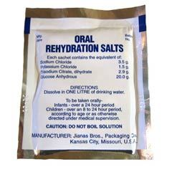

Slide 13
LAXATIVES
Stimulant laxatives- Bisacodyl,Senna
Bulk-Cellulose- Isphagula husk-Bran-sterculia
Faecal softners- Liquid Paraffin
Osmotic luxatives- Magnesium Hydroxide- Lactulose. Polyethlene glycol

Slide 14
MANAGEMENT OF CONSTIPATION
Rule out medical problems- Hypothyroidism/Drugs
Rule out surgical problems, Malignancy
General measures- Increase fluid intake
Increase fibre intake

Slide 15
GASTROINTESTINAL STIMULANTS
Act on the bowel stimulating peristalsis and reducing net absorption of water and electrolytes
Bisacodyl(Dulcolax) can be given orally /rectally for faster action
Used in the treatment of constipation and in the preparation for radiologic examinations. Eg X ray GUT
Tegaserod is indicated in constipation predominent IBS

Slide 16
BULK- FORMING AGENTS
Hydrophilic compounds act by absorbing water,swell and increases stool bulk
Increased stool bulk stimulates rectal reflexes and promotes defecation
Bran, Ispaghula husk

Slide 17
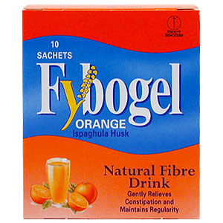

Slide 18
FAECAL SOFTNERS AND LUBRICANTS
Liquid paraffin( Cremaffin contains liquid paraffin AND Magnesium hydroxide))

Slide 19
OSMOTIC LUXATIVES
Reduces the water reabsorption from the intestines
Lactulose is fermented to acetic acid and lactic acid in the bowel which act as osmotic laxatives
Lactulose takes 48 hrs to act
Lactulose is also used in hepatic encephalopathy.
Can cause troublesome bloating

Slide 20
BALANCED POLYETHELENE GLYCOL
Used for colonic cleansing before gastrointestinal endoscopic procedures.
Balanced isotonic solution. No dehydration or electrolyte imbalance
2-4 litres over 2-4 hours
Smaller doses used in chronic constipation

Slide 21
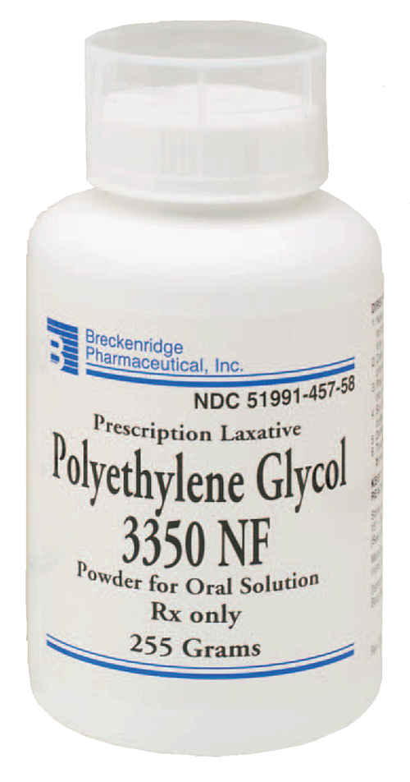

Slide 22
PHOSPHATE ENEMAS
Osmotic laxative
Used rectally
Used in Hepatic encephalopathy

Slide 23
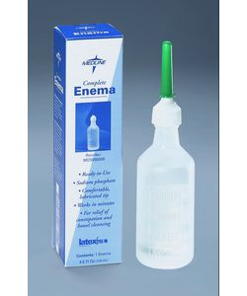

Slide 24
INDICATIONS FOR THE USE OF LAXATIVES/PURGATIVES
Constipation
Bowel cleansing Surgery/Radiology
Anal conditions-Anal fissure/Haemorrhoids
Bed ridden patients
IBS- C

Slide 25
ANTICHOLINERGICS/ANTISPASMODICS
Hyoscine butylbromide(Buscopan)
Propantheline bromide
Mebeverine- smooth muscle relaxant- used in IBS

Slide 26
IRRITABLE BOWEL SYNDROME
Abnormal bowel symptoms without obvious organic cause
explanation, avoiding precipitating food and symptomatic treatment
Symptomatic treatment with anti diarrhoeals
Antidepressants- Imipramine

Slide 27
RIFAXIMIN
Useful in
  Hepatic encephalopathy
  Gastroenteritis
  Irritable bowel syndrome

Slide 28
INFLAMMATORY BOWEL DISEASE
Ulcerative colitis. Presents with blood and mucous diarrhoa
Crohn’s Disease presents with diarhoea RIF pain and weight loss.

Slide 29
ULCERATIVE COLITIS/ CROHN’S DISEASE
corticosteroids
sulphasalazine
Azathioprine

